Slide 1
IFTA, Inc. Update
2017 Annual IFTA Business Meeting
Chandler, AZ
Presented by:
Lonette L. Turner, CEO
August 9, 2017

Slide 2
IFTA, Inc.
Debora K. Meise
Senior Director
Amanda M. Koeller
Comptroller
Jason DeGraf
Information Services Director
Tom King
Webmaster
Tammy Trinker
Office and Events Administrator
Maria Coronado
Membership Services Officer

Slide 3
Board Members
New Board Members
Elected at 2016 ABM
Rick LaRose (CT)
Antoinette Tannous (QC)
Elected Mid-Term to replace David Helton (FL)
Rick Taylor (KY)
After this morning’s election, five (5) of our nine (9) Board members will have served one year or less on the Board

Slide 4
Board Members
Chuck Ulm (MD)
President
Steve Nutter (VA)
First Vice President
Joy Prenger (MO)
Second Vice President
Cindy Arnold (NV)
Trent Knoles (IL)
Rick LaRose (CT)
Antoinette Tannous (QC)
Rick Taylor (KY)
Stuart Zion (CO)

Slide 5
Strategic Plan Items
Planning a Board Governance training in conjunction with the January 2018 Board meeting
Audits: Completion of Audited Financial Statements and Service Auditors Report
No Adjustments and No Exceptions
IFTA, Inc. Remains in Good Standing Financially
Remote Work Schedule for Staff Members
Came in handy as you will see later
Quarterly Conference Calls with the Member Jurisdictions and Board Liaisons

Slide 6
Strategic Plan Items
Partnerships
Participation on the IRP Electronic Credentials Task Force
Just back from meeting held August 1 and 2
AAMVA Motor Carrier Working Group – Support
I-95 Corridor Project – Support
IRP, Inc. - Everything

Slide 7
Strategic Plan Items
Committee Meetings –
Clearinghouse Advisory Committee
Quality Control
Best Practices
Program Compliance Review Committee and Working Group

Slide 8
Clearinghouse
OK is now a full participating member of the Clearinghouse and uploaded its first transmittal in July.
Implemented demographic data quality control checks and new e-mail notifications.
Re-wrote and released more web services concentrating on Demographics.

Slide 9
Clearinghouse
Re-wrote and released more web services concentrating on Demographics.
Hardware and Software upgrades for every Clearinghouse based server.
Worked with many jurisdictions in light of the data quality control check and full file uploads, and established new data connections as jurisdictions switch data providers

Slide 10
Funds Netting
54 Participants
$375MM
53 Participants
$364MM
50 Participants
$362MM
47 Participants
$328MM

Slide 11
Website
Website was modernized
5 ways to view the Tax Rate Matrix
New IFTA Events page to keep track important IFTA events
Web traffic is encrypted via HTTPS
Nearly 1,000 pages, every single page of IFTA, Inc. was redesigned

Slide 12
Program Compliance Reviews
We continue to work with the member jurisdictions to assist with compliance by conducting reviews and working with the Program Compliance Committee
Debbie was instrumental in staying up to date with reviews before Pat Platt’s replacement was hired. A lot of extra work that was done well.

Slide 13
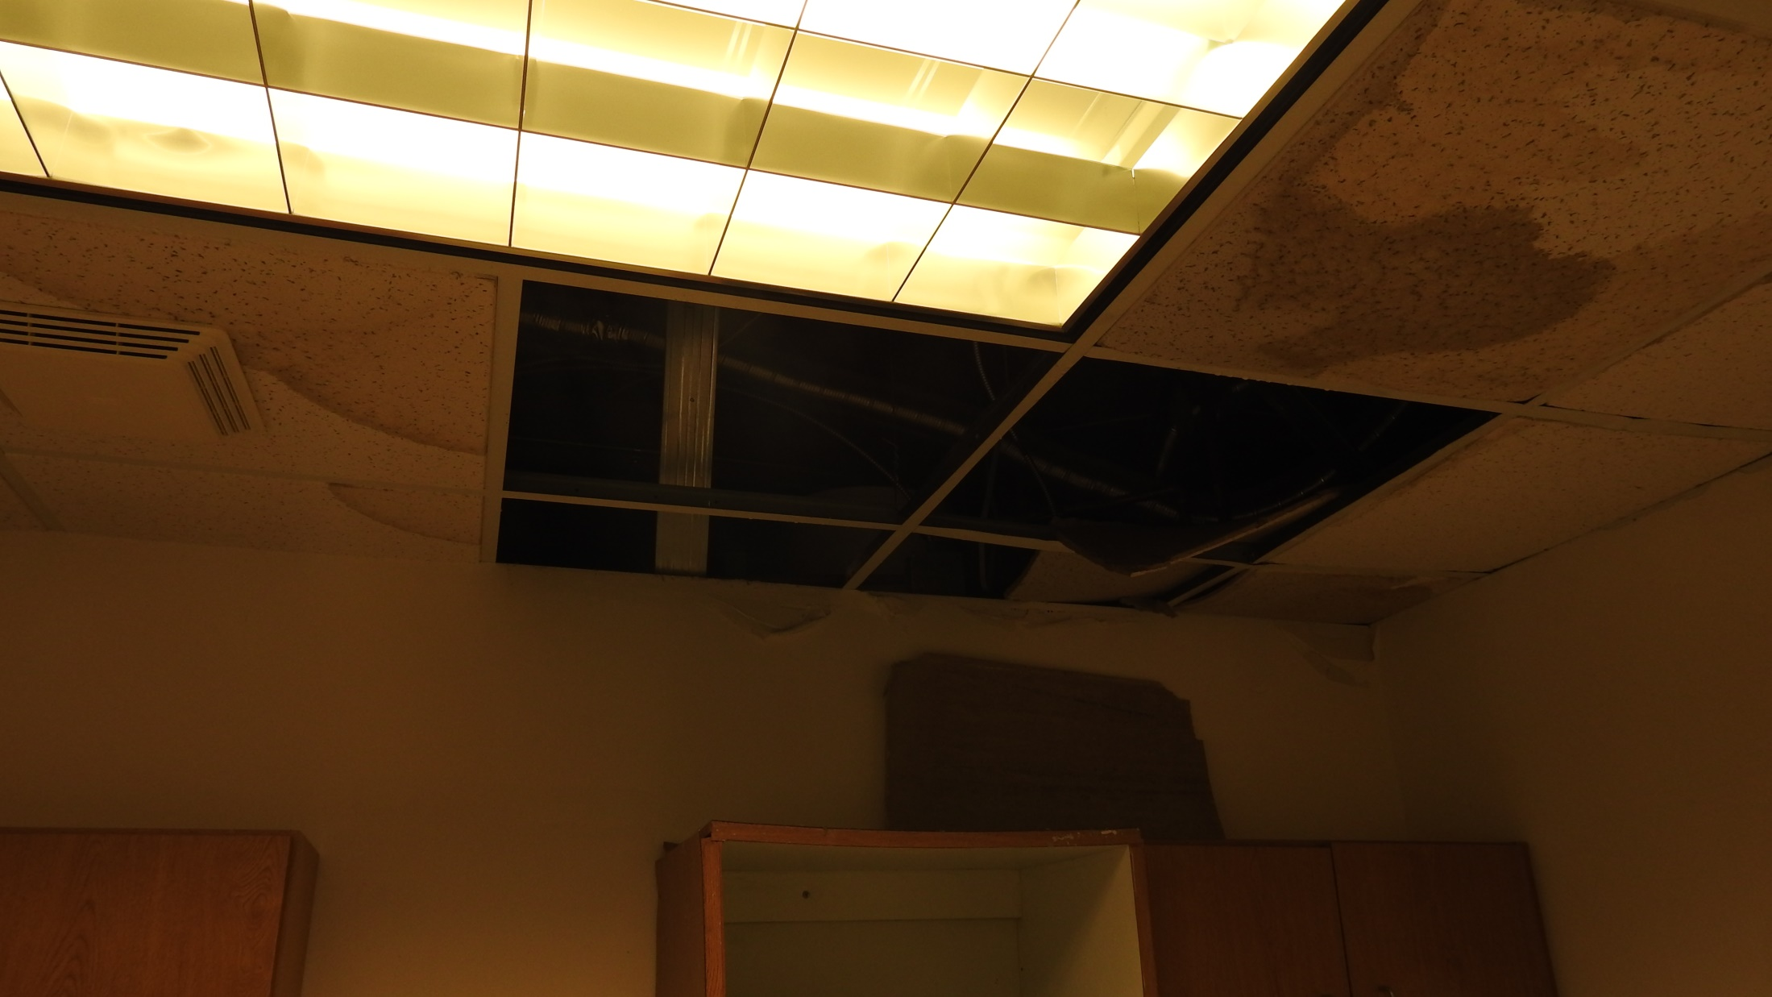
The Great Water Heater Blow Out of 2017

Slide 14
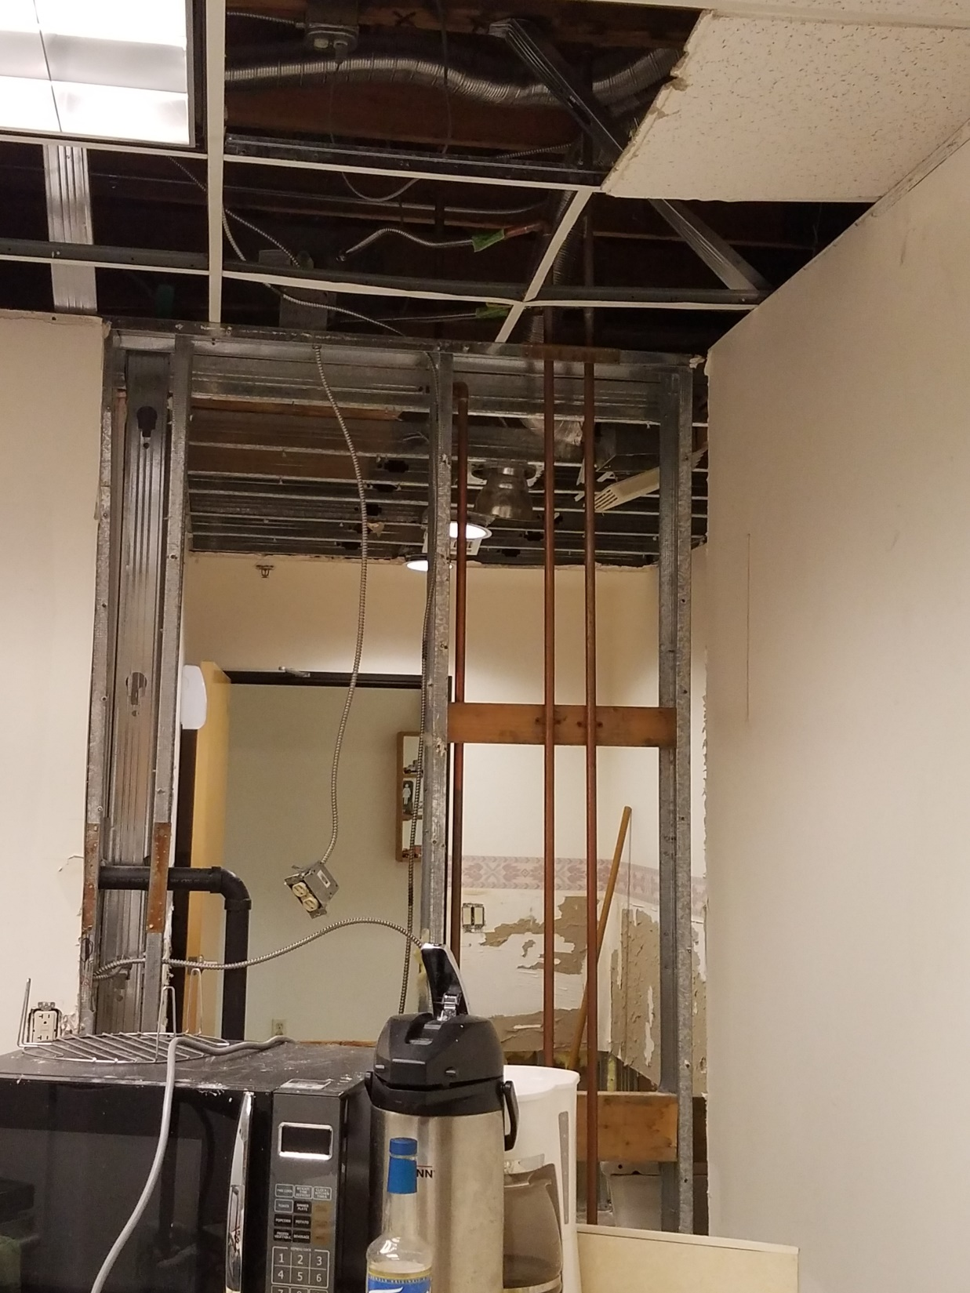

Slide 15
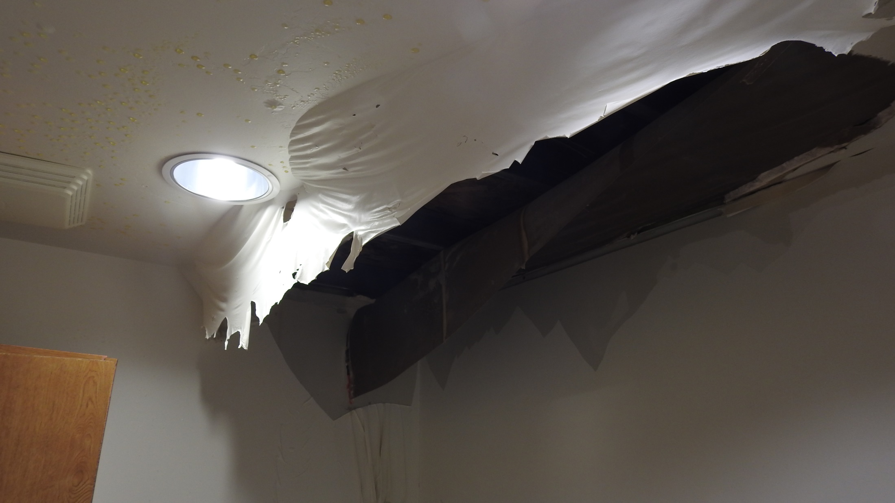

Slide 16
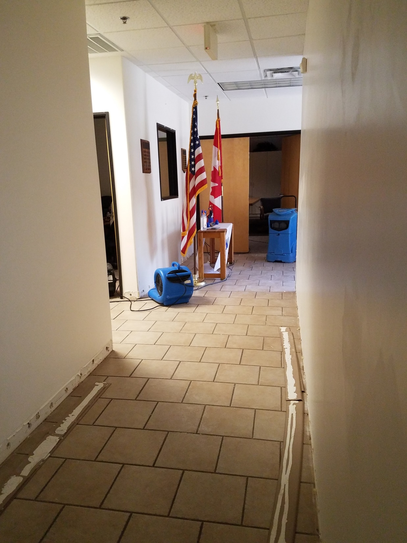
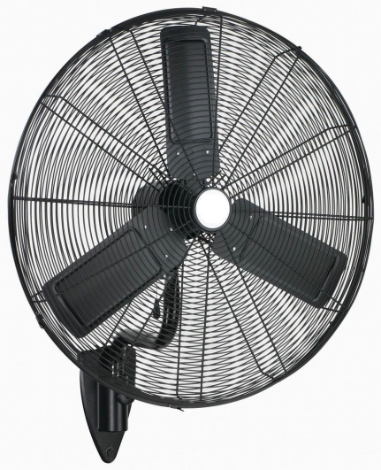

Slide 17
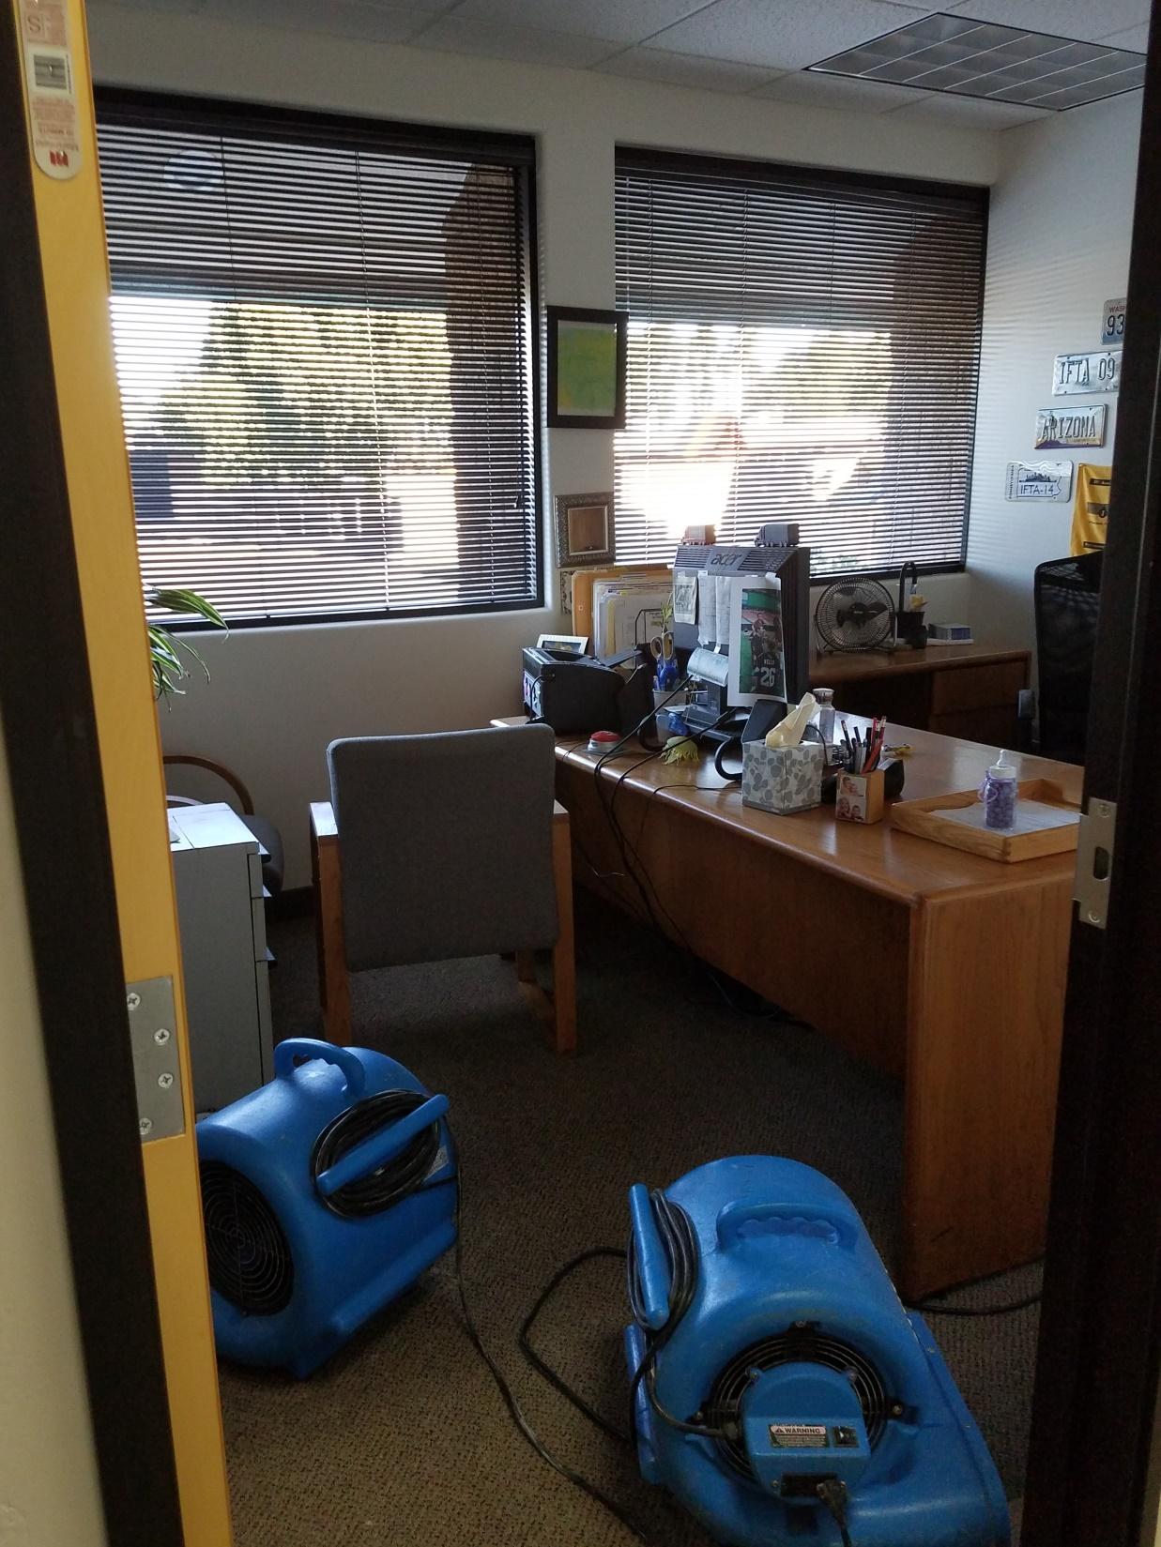

Slide 18
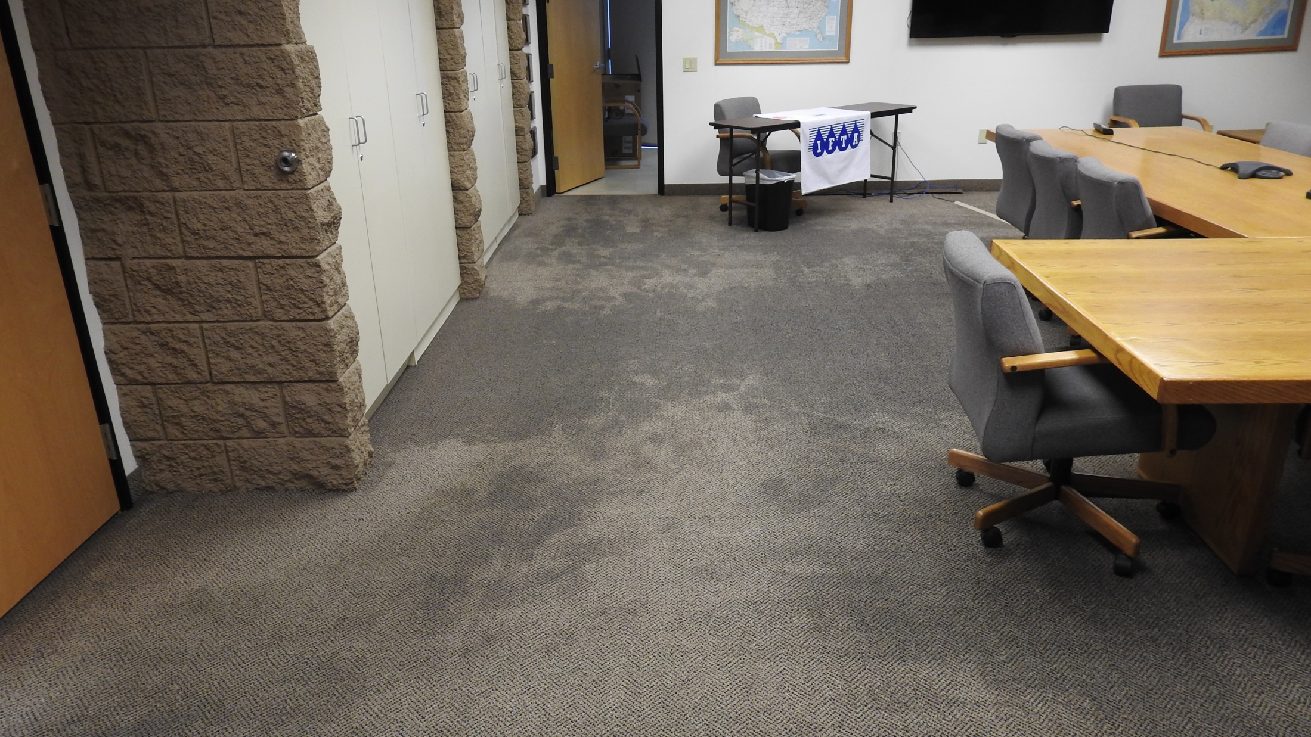

Slide 19
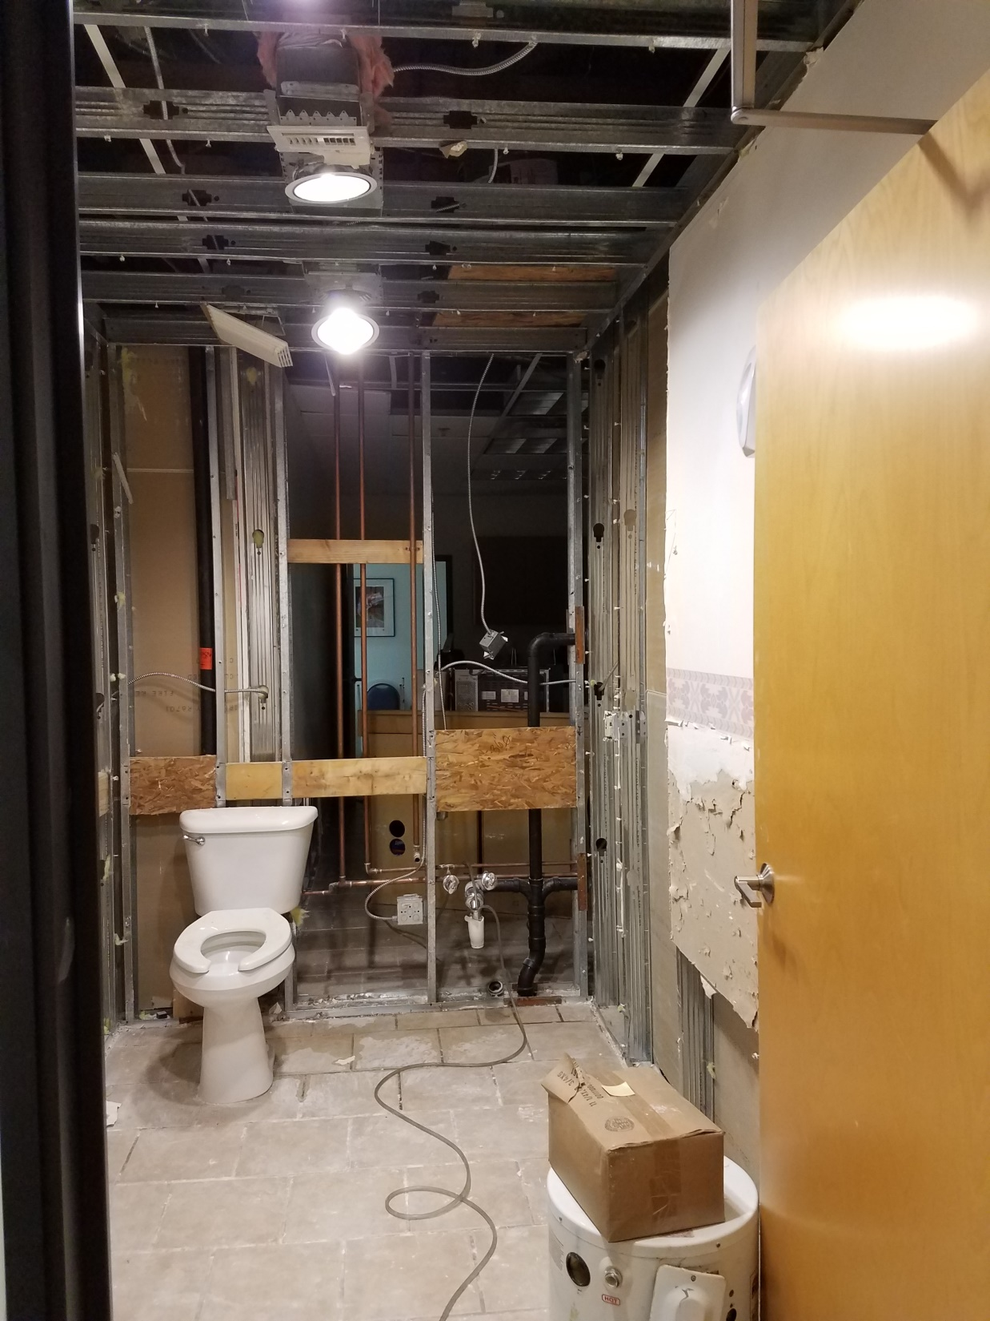

Slide 20
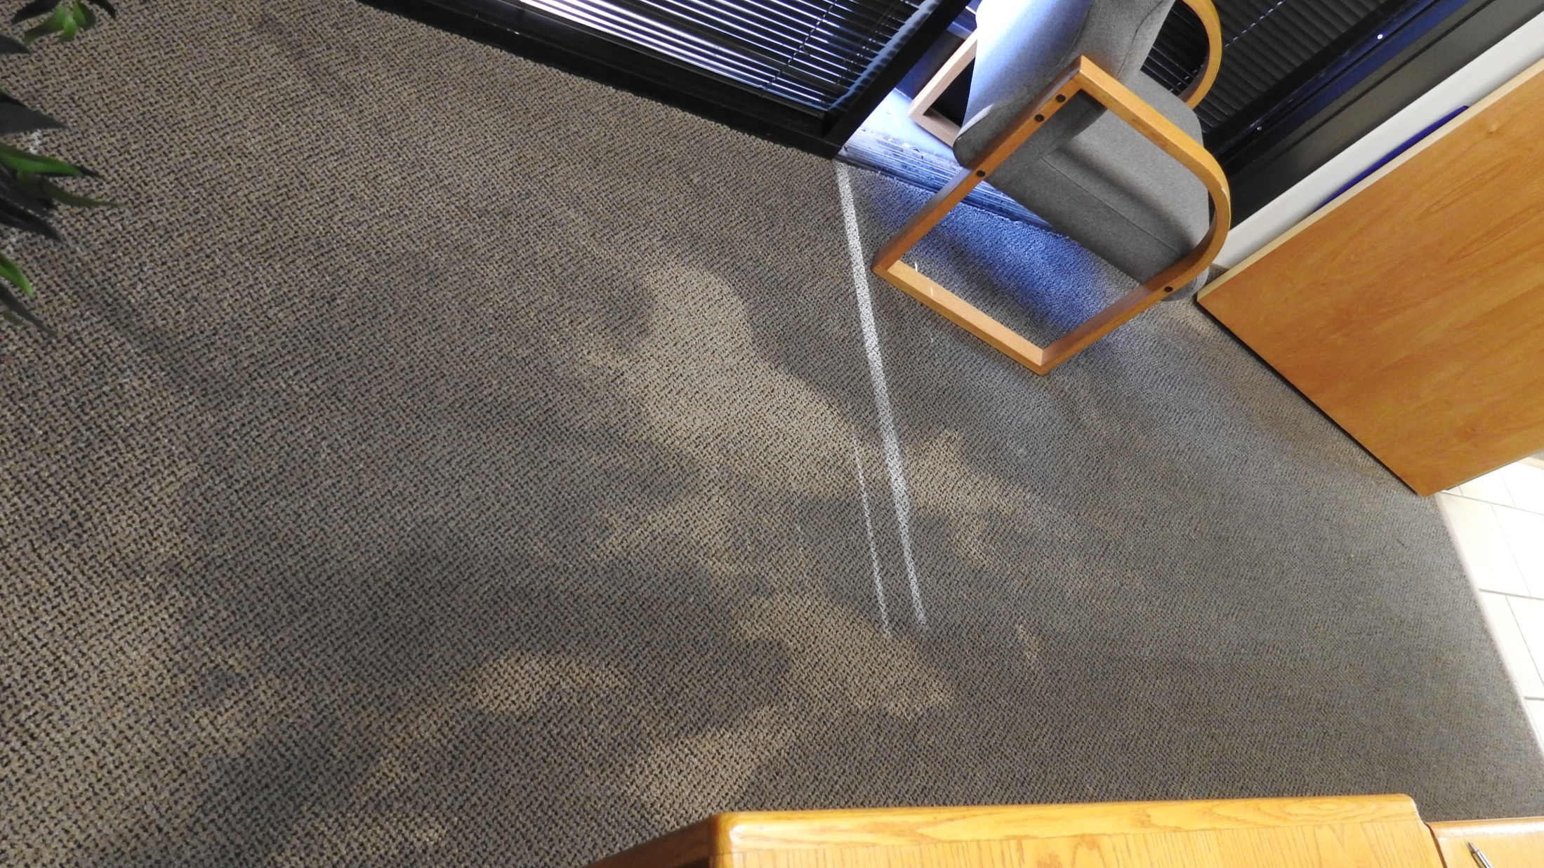

Slide 21
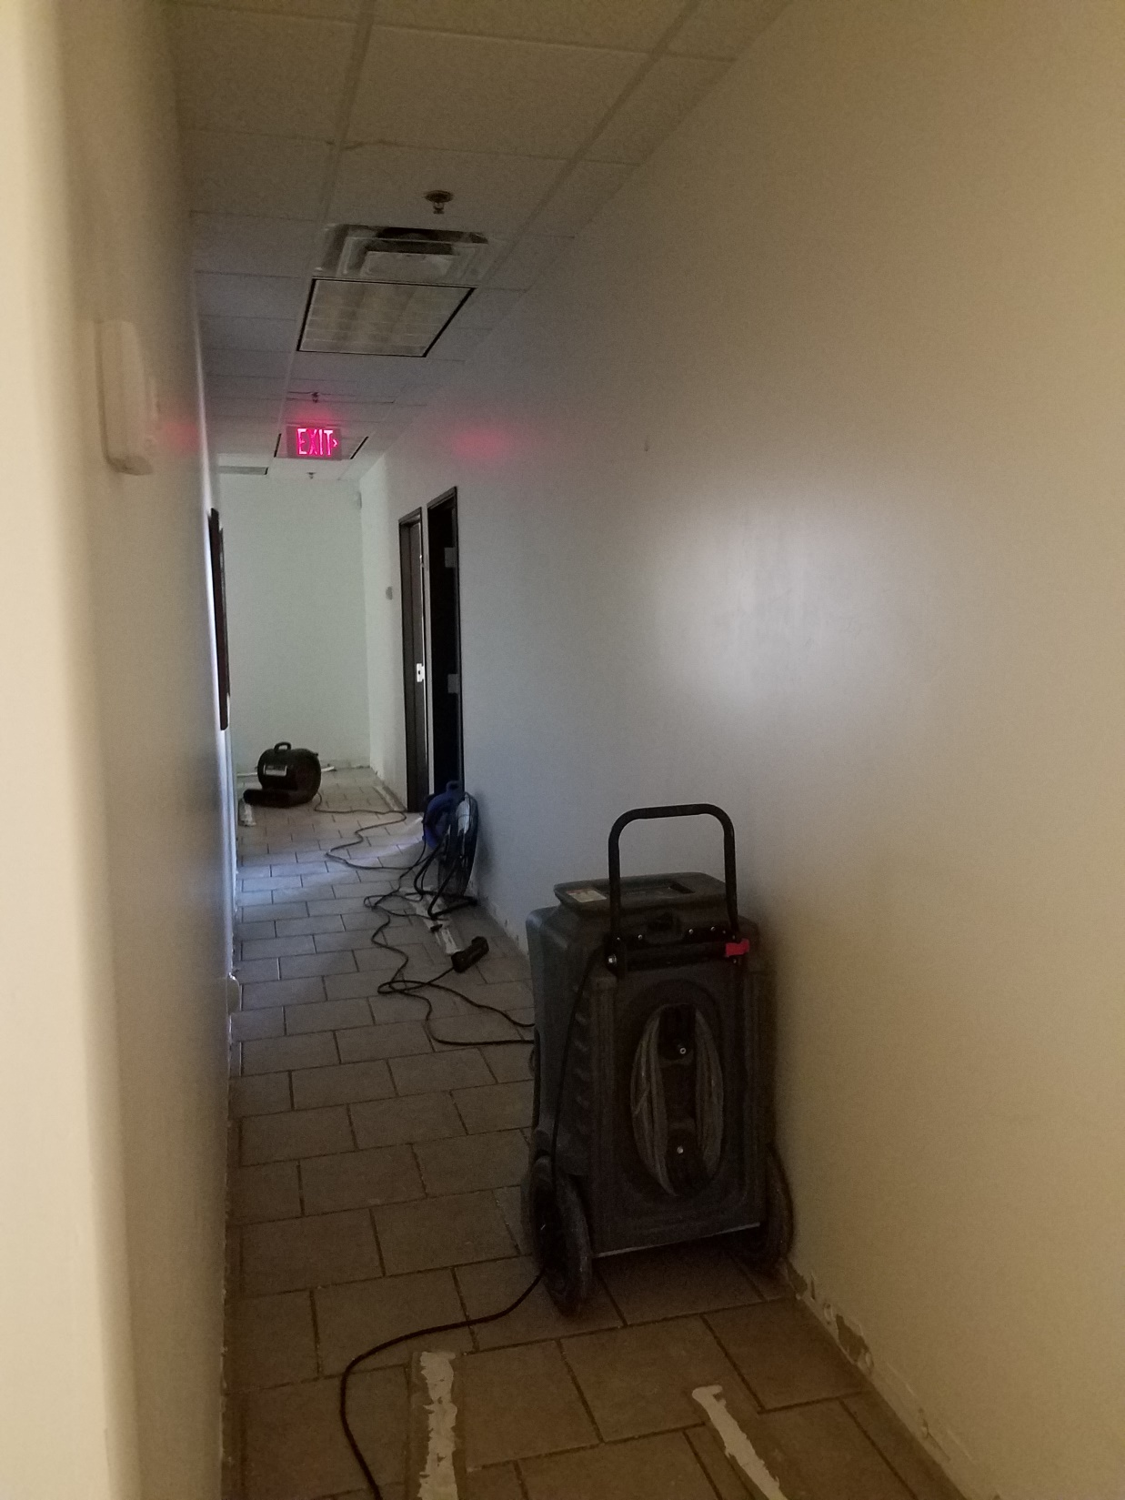

Slide 22
What Do You Do?

Slide 23
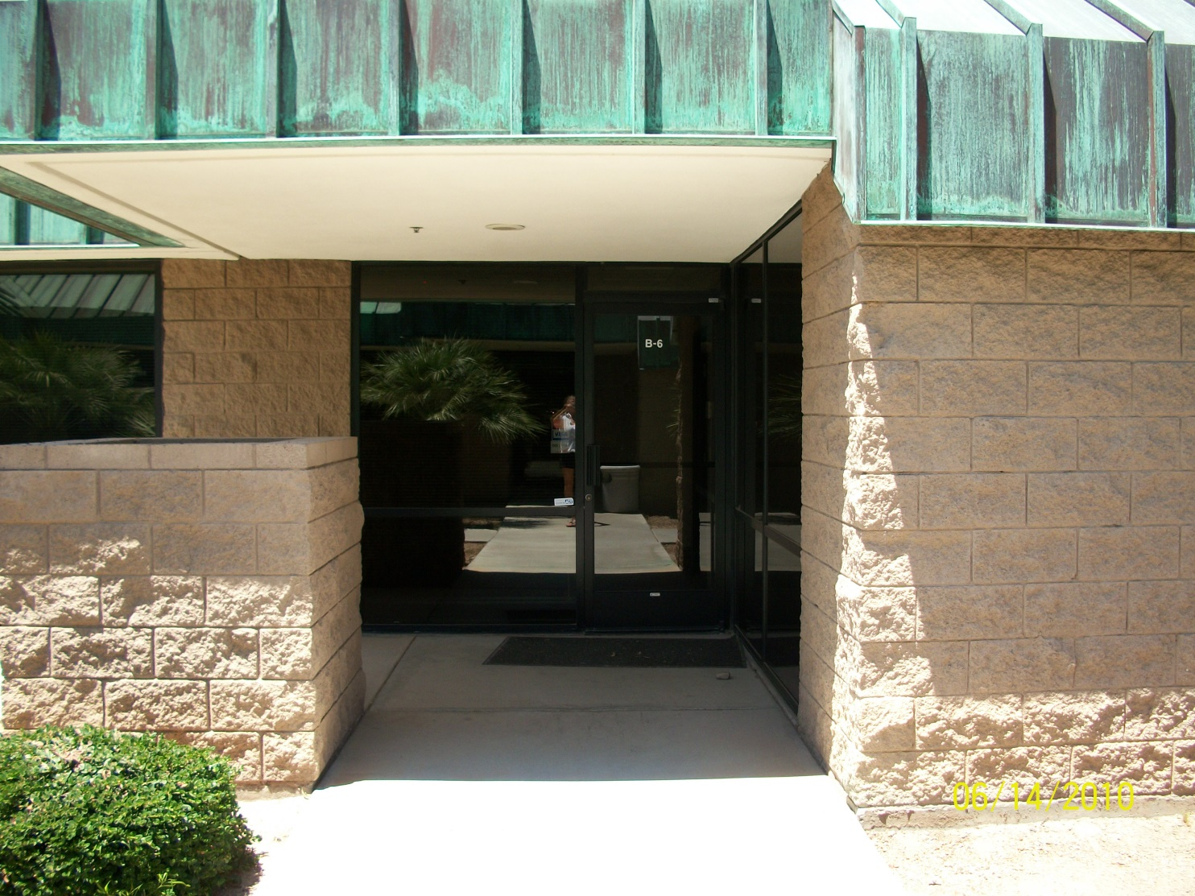
Where do you go?
From Suite B-7 to Suite B-6

Slide 24
Why Go There?
Leasing a much smaller space back from the Buyer
Lease term 5 years. However, we built in an option to terminate after 2, 3 or 4 years with 120 days notice. No penalty for the early out.
That way, we can take a bit more time to determine whether to purchase a small condo office or work remotely.

Slide 25
Critical Dates
Purchase Agreement Signed 7-26-17
Closing – 9-7-17
Suite B-6 available – 8-21-17
Moving Dates – 8-21-17 through 9-7-17
We anticipate servers being down only a few hours and will notify well in advance of the date and time

Slide 26
What Has Transpired
I signed the documents when I arrived in Indiana on 7-26-17.
Since that date, and in my absence, the employees of IFTA, Inc. have accomplished so much.
A calendar for the move, with assignments, based on critical dates

Slide 27
What Has Transpired
Many calls to office furniture liquidators to try to sell the large furniture that will not fit in the smaller suite
Walk through of the smaller suite to plan out the move and diagram offices, etc.
Contact with phone and internet service providers to plan for the move.

Slide 28
What Has Transpired
Remodel finalized
Furniture and boxes returned to the current office
Scheduling week of August 14 to go through boxes before they are moved
All of this work in addition to their daily responsibilities without a service failure.
Thank you Amanda, Debbie, Jason, Maria, Tammy and Tom!

Slide 29
FYE18?
Off to a good start with a great staff, working on what we have while we await what is new.
One of the first things is to implement the travel funding for one person to attend an IFTA Meeting. We’ll start with the 2018 Audit Workshop.

